Slide 1
Cost Of Living Analysis
By RUDDHI RANI

Slide 2
Abstract
This project revolves around the analysis of the cost of living in various cities and countries across the globe. The dataset used for this analysis encompasses a wide range of economic indicators, from the price of basic commodities to the cost of housing, transportation, and even entertainment.

Slide 3
Dataset Information
The dataset utilized in this project is sourced from Numbeo, a collaborative online database that provides cost of living information worldwide.
It contains 56 columns, including information about cities, countries, and a wide array of cost-related variables, ranging from grocery prices to real estate costs.
The dataset is designed to offer a comprehensive view of the economic aspects of various locations, making it a valuable resource for conducting cost of living analyses.

Slide 4
Variable Description
city Name of the city
• countryName of the country
• x1 Meal, Inexpensive Restaurant (USD)
• x2 Meal for 2 People, Mid-range Restaurant, Three-course (USD)
• x3 McMeal at McDonalds (or Equivalent Combo Meal) (USD)
• x4 Domestic Beer (0.5 liter draught, in restaurants) (USD)
• x5 Imported Beer (0.33 liter bottle, in restaurants) (USD)
• x6 Cappuccino (regular, in restaurants) (USD)
• x7 Coke/Pepsi (0.33 liter bottle, in restaurants) (USD)
• x8 Water (0.33 liter bottle, in restaurants) (USD)
• x9 Milk (regular), (1 liter) (USD)
• x10 Loaf of Fresh White Bread (500g) (USD)
• x11 Rice (white), (1kg) (USD)
• x12 Eggs (regular) (12) (USD)

Slide 5
x13 Local Cheese (1kg) (USD)
• x14 Chicken Fillets (1kg) (USD)
• x15 Beef Round (1kg) (or Equivalent Back Leg Red Meat) (USD)
• x16 Apples (1kg) (USD)
• x17 Banana (1kg) (USD)
• x18 Oranges (1kg) (USD)
• x19 Tomato (1kg) (USD)
• x20 Potato (1kg) (USD)
• x21 Onion (1kg) (USD)
• x22 Lettuce (1 head) (USD)
• x23 Water (1.5 liter bottle, at the market) (USD)
• x24 Bottle of Wine (Mid-Range, at the market) (USD)
• x25 Domestic Beer (0.5 liter bottle, at the market) (USD)
• x26 Imported Beer (0.33 liter bottle, at the market) (USD)
• x27 Cigarettes 20 Pack (Marlboro) (USD)
• x28 One-way Ticket (Local Transport) (USD)
• x29 Monthly Pass (Regular Price) (USD)
• x30 Taxi Start (Normal Tariff) (USD)
• x31 Taxi 1km (Normal Tariff) (USD)
• x32 Taxi 1hour Waiting (Normal Tariff) (USD)
• x33 Gasoline (1 liter) (USD)

Slide 6
• x45 1 Summer Dress in a Chain Store (Zara, H&M, ...) (USD)
• x46 1 Pair of Nike Running Shoes (Mid-Range) (USD)
x47 1 Pair of Men Leather Business Shoes (USD)
• x48 Apartment (1 bedroom) in City Centre (USD)
• x49 Apartment (1 bedroom) Outside of Centre (USD)
• x50 Apartment (3 bedrooms) in City Centre (USD)
• x51 Apartment (3 bedrooms) Outside of Centre (USD)
• x52 Price per Square Meter to Buy Apartment in City Centre (USD)
• x53 Price per Square Meter to Buy Apartment Outside of Centre (USD)
• x54 Average Monthly Net Salary (After Tax) (USD)
• x55 Mortgage Interest Rate in Percentages (%), Yearly, for 20 Years Fixed-Rate
• data_quality 0 if Numbeo considers that more contributors are needed to increase data quality, else 1data_quality: A binary variable (0 or 1) indicating data quality, with 0 suggesting the need for more contributors and 1 indicating satisfactory data quality.
• x34 Volkswagen Golf 1.4 90 KW Trendline (Or Equivalent New Car) (USD)
• x35 Toyota Corolla Sedan 1.6l 97kW Comfort (Or Equivalent New Car) (USD)
• x36 Basic (Electricity, Heating, Cooling, Water, Garbage) for 85m2 Apartment (USD)
• x37 1 min. of Prepaid Mobile Tariff Local (No Discounts or Plans) (USD)
• x38 Internet (60 Mbps or More, Unlimited Data, Cable/ADSL) (USD)
• x39 Fitness Club, Monthly Fee for 1 Adult (USD)
• x40 Tennis Court Rent (1 Hour on Weekend) (USD)
• x41 Cinema, International Release, 1 Seat (USD)
• x42 Preschool (or Kindergarten), Full Day, Private, Monthly for 1 Child (USD)
• x43 International Primary School, Yearly for 1 Child (USD)
• x44 1 Pair of Jeans (Levis 501 Or Similar) (USD)

Slide 7
Data Processing and Cleaning
Ensure the dataset is free of missing values and inconsistencies.
Standardize the format of the data for consistency.
Remove any outliers that could skew the analysis.

Slide 8
Exploratory Data Analysis
Calculate summary statistics for each variable.
Identify trends and patterns in the data.
Visualize distributions and relationships among variables.

Slide 9
Data Visualization in PowerBi
Setup Power BI:
Import the cleaned dataset into Power BI.
Create Interactive Dashboards:
Develop dashboards that allow users to filter and explore the data by city, country, and different cost components.

Slide 10
Data Visualization in PowerBi
3. Visualize Key Insights:
Use a variety of visualizations such as:
Bar charts for comparing costs across cities.
Line charts for trends over time.
Pie charts for the composition of costs.
Maps for geographic visualization of cost differences.

Slide 11
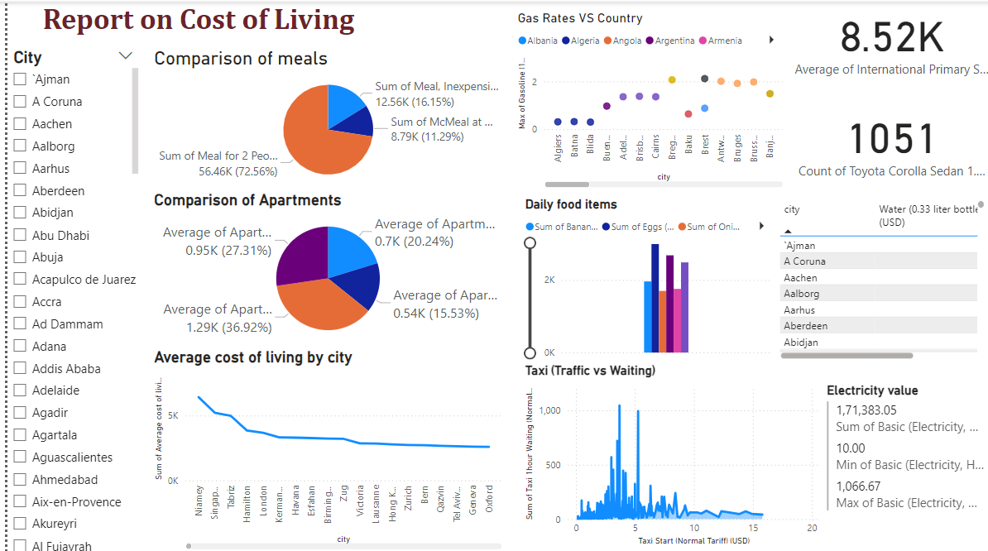

Slide 12
Interpretation of Results
Identify Highest and Lowest Costs:
Rank cities and countries by overall cost of living and by specific cost components.
Major Cost Components:
Analyze which components (e.g., housing, transportation, food) contribute most to the cost of living in different regions.

Slide 13
Interpretation of Results
3. Correlate Factors:
Examine how average salaries, housing costs, and transportation expenses correlate with overall cost of living.
4. Draw Conclusions:
Summarize key findings and provide actionable insights for individuals and organizations considering relocation or investment decisions.

Slide 14
Results:
City with highest cost of living:
Niamey( Niger)
353293.45( total cost)
City with lowest cost of living:
Jodhpur( India)
23033.68( total cost)

Slide 15
Results:
5 major cost components in cost of living include:
Toyota and Volkswagen with 24447 and 24105
International Primary School with 8520
Apartment in city and outside with 3560 and 2476

Slide 16
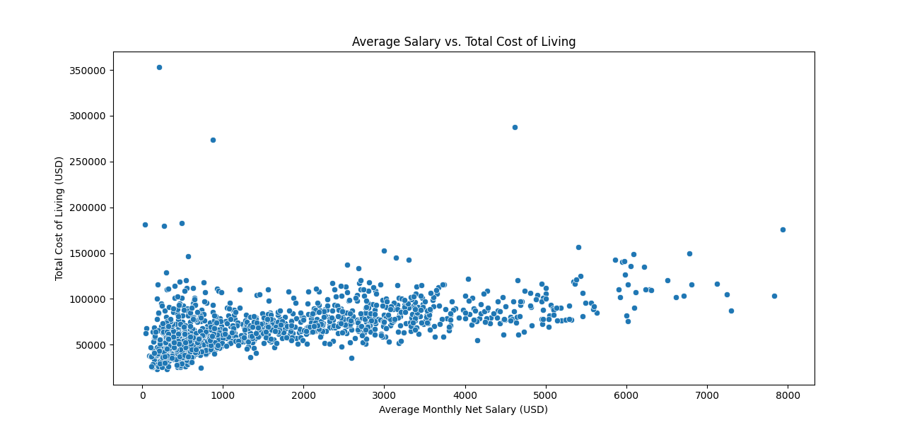
Results
Here we can see a correlation between average salary and total cost of living.
It increases gradually.

Slide 17
Conclusion:
We have analyzed , visualized and understood the data properly and found important insights to further work with.

Slide 18
THANK YOU

